Slide 1

GHP 60 Engineering Introduction
Anish Goyal

Slide 2

My Picture Collage

Slide 3
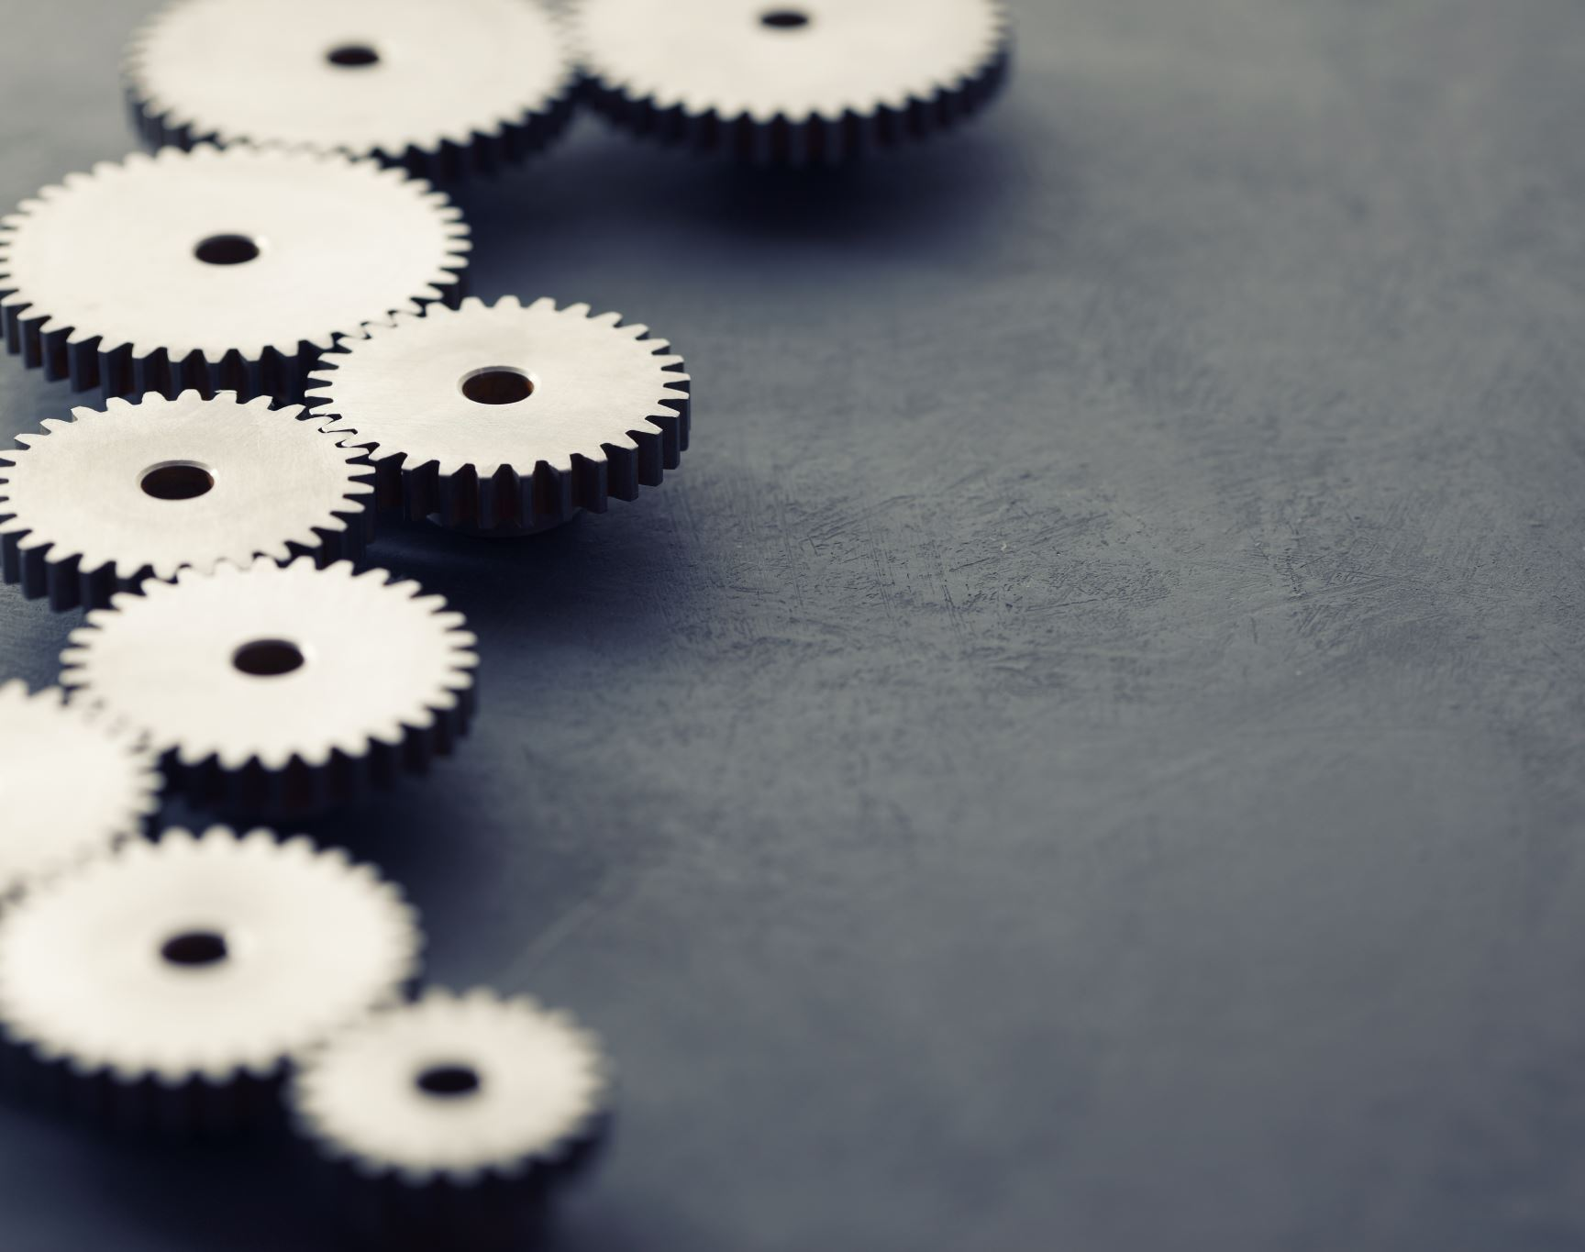
Engineering Marvel

Slide 4
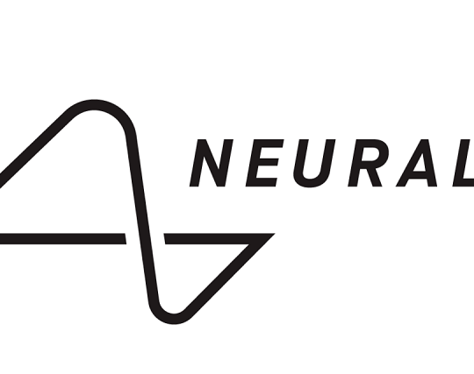
Neuralink Brain-Machine Interface
Neuralink aims to merge human brains with artificial intelligence (AI) and other advanced technologies.
Founded by Elon Musk in 2016.
Neurological Disorders: Neuralink holds promise in treating various neurological conditions like Parkinson's disease, epilepsy, and spinal cord injuries.
Brain-Computer Interfaces: The technology opens up possibilities for controlling computers, prosthetic limbs, and other external devices using just thoughts.

Slide 5

Engineering Disaster

Slide 6
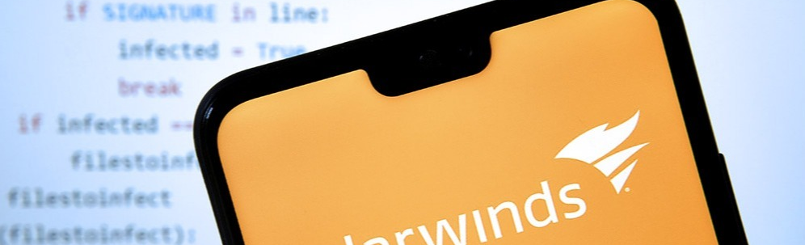
SolarWinds Cyberattack
One of the most significant and impactful cybersecurity breaches in recent times.
Malicious code was inserted into software updates, which were then distributed to SolarWinds' customers, including government agencies and major corporations.
Highlighted the risks associated with supply chain attacks and the need for enhanced security measures in software development and distribution.
Went undetected for months

Slide 7
References
Musk ; NeuralinkNeuralink, E., Musk, E., Neuralink, & Corresponding Author:Elon MuskNeuralink3180 28th StreetSan Francisco. (n.d.). An integrated brain-machine interface platform with thousands of channels. Journal of Medical Internet Research. https://www.jmir.org/2019/10/e16194/
Office, U. S. G. A. (2023, April 20). Solarwinds cyberattack demands significant federal and private-sector response (infographic). U.S. GAO. https://www.gao.gov/blog/solarwinds-cyberattack-demands-significant-federal-and-private-sector-response-infographic
Person, & Rachael Levy, M. T. (2023, May 26). Elon Musk’s Neuralink wins FDA approval for human study of brain implants. Reuters. https://www.reuters.com/science/elon-musks-neuralink-gets-us-fda-approval-human-clinical-study-brain-implants-2023-05-25/
Temple-Raston, D. (2021, April 16). A “worst nightmare” cyberattack: The untold story of the solarwinds hack. NPR. https://www.npr.org/2021/04/16/985439655/a-worst-nightmare-cyberattack-the-untold-story-of-the-solarwinds-hack

